Slide 1

Deploy applications on Azure in Kubernetes (AKS)
by
Rupesh Kumar
11th Dec 2019

Slide 2
Containers

Slide 3
What is container
A container is a standard unit of software that packages up code and all its dependencies so the application runs quickly and reliably from one computing environment to another. ~~ docker.com

Slide 4
What is
image
An image is a lightweight, standalone, executable package of software that includes everything needed to run an application: code, runtime, system tools, system libraries and settings.

Slide 5
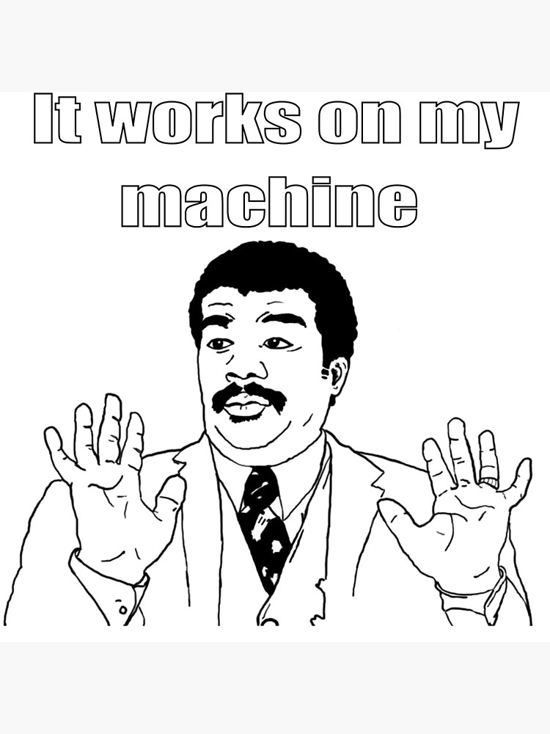
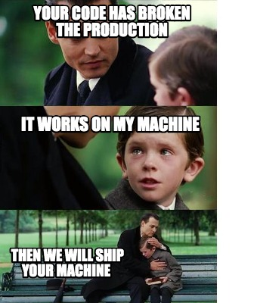
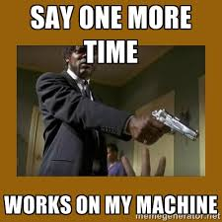
What problem containers solve?
Notes:
When I create an application on .net 4.7 and deploy on iis. I am only deploying binaries

Slide 6
But how
An image is a lightweight, standalone, executable package of software that includes everything needed to run an application: code, runtime, system tools, system libraries and settings.
Image
Layer3
Layer2
Layer1
Dockerfile
FROM mcr.microsoft.com/dotnet/core/sdk:3.0-buster AS build
RUN dotnet publish "DemoAppLinux.csproj" -c Release -o /app/publish
ENTRYPOINT ["dotnet", "DemoAppLinux.dll"]

Slide 7
KUBERNETES?
Buzzword or Game Changer

Slide 8
Kubernetes is shaping the future of app development and management
Why Kubernetes?
As per Gartner, Kubernetes is taking the app development world by storm.
By 2022, more than 75% of global organizations will be running containerized applications in production.

Slide 9
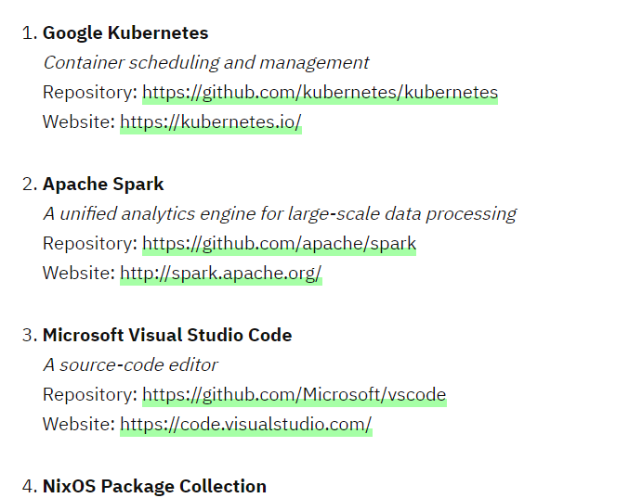
Why Kubernetes?
Most Valuable Repositories Out of 96 Million
Source: https://hackernoon.com/githubs-top-100-most-valuable-repositories-out-of-96-million-bb48caa9eb0b

Slide 10
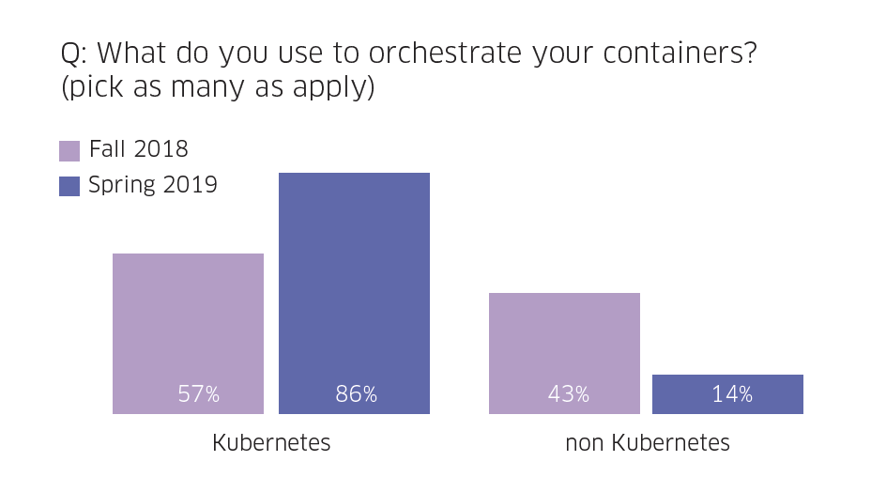

Slide 11
What is Kubernetes? Kubernetes is a portable, extensible, open-source platform for managing containerized workloads and services.

Slide 12


| What is Kubernetes?
Pod1
Pod2
Pod3
Pod4
Container 2
Container 1

Slide 13
|Kubernetes Architecture
Api Server
Kubelet
Kube-Proxy
Etcd cluster
Kube scheduler
Kubelet
Kube-Proxy

Slide 14

|Kubernetes Architecture
Kubectl get nodes
NAME STATUS ROLES AGE VERSION
aks-nodepool1 Ready agent 17h v1.13.12
Authenticates Req
Validates Req
Get info from etcd
Return response
Api Server
Kubelet
Etcd cluster
Kube-Proxy
Kube scheduler
Kubelet
Kube-Proxy

Slide 15
What is POD?
A Pod is the smallest unit
A Pod is the unit which runs your workload
Pod definition yaml
apiVersion: v1
kind: Pod
metadata:
name: myapp-pod
spec:
containers:
- name: myapp-container
image: nginx
ports:
- containerPort: 80
Pod1
Container 2
Container 1
Notes:
A Pod is the basic execution unit of a Kubernetes application–the smallest and simplest unit in the Kubernetes object model that you create or deploy.
A Pod represents processes running on your cluster.

Slide 16
| What is deployment?
Deployment is preferred way to deploy PODs
Deployment is used to create multiple PODs
Rollback to an earlier Deployment revision
Scale up the Deployment to facilitate more load
Pause the Deployment

Slide 17
What is service?
A Service is an abstraction which defines a logical set of Pods and a policy by which to access them.
Notes:
Kubernetes Pods are mortal. They are born and when they die, they are not resurrected. If you use a Deployment to run your app, it can create and destroy Pods dynamically.
Each Pod gets its own IP address, however in a Deployment, the set of Pods running in one moment in time could be different from the set of Pods running that application a moment later.
This leads to a problem: if some set of Pods (call them “backends”) provides functionality to other Pods (call them “frontends”) inside your cluster, how do the frontends find out and keep track of which IP address to connect to, so that the frontend can use the backend part of the workload?

Slide 18
| Kubernetes service
FrontEnd Pods
FrontEnd Pods
Backend Service
Backend Pods
BackEnd Pods

Slide 19
Lets begin
with hands on

Slide 20
Some important points
Root path are relative to assignment folder. So cd to assignment.
Difference between mac & powershell variable.
This is not a competition or race. Read the comments understand them and then try.

Slide 21
Lets start
https://github.com/rupeshtech/meetup11thdec2019

